Slide 1

Notes:
Lewis: GoodMorning, First thing first, Head to this google link, and lets get you downloading the necessary packages.

Slide 2
Jason Manuel
Technical Development Director
Notes:
So lets start with the basics. As a programmer, what do you have to do, What do you have to know?

Slide 3


Slide 4
CSS Background
What is CSS?
Stands for Cascading Style Sheets
Styling and variation
Helps you make HTML look pretty

Slide 5
CSS Basics
Describe the style, arrangement, position of HTML elements on a webpage
Style definitions are normally saved in .css files that the browser engine compiles
Styling in an HTML doc - via <style></style> tags
Placed between <head></head> tags

Slide 6
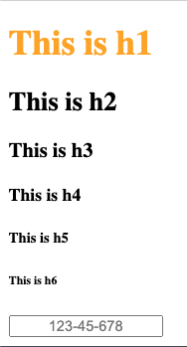
CSS Rules
h1 {
color: orange;
}
input {
text-align: center;
}
declaration
selector
Notes:
Bottom box is input element

Slide 7
CSS Selectors
Universal Selector
* {
align-content: center;
}
Grouping Selectors
h1, h2, h3 {
color: red;
}
class Selector
.CIDSE {
font-size: 150%;
}
id Selector
#apple {
font-style: italic;
}

Slide 8

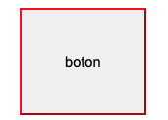
Box Model
The box model wraps around every HTML element (incl. divs)
Margin, border, padding: top, right, bottom, left
button {
padding: 40px;
border-color: red;
margin: 0px 10px 0px 10px;
}
via w3schools.com
Notes:
keep

Slide 9

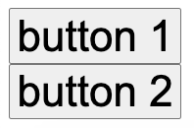

The display property
display: inline; /* put elements on the same line */
display: block; /* put each element on a new line */
display: inline-block; /* element gets a block box, but is put on the same line */
Notes:
Inline block: like a block for purposes of margin and padding and layout in containing elements

Slide 10
The position property
position: static; /* the default: element is */
display: block; /* put each element on a new line */
display: inline-block; /* element gets a block box, but is put on the same line */
Notes:
Inline block: like a block for purposes of margin and padding and layout in containing elements

Slide 11
External Stylesheets and inline-styling
Add externals stylesheets using the <link> tag:
<head>
<link rel="stylesheet" href="demo.css">
</head>
Must not contain any html
Separate stylesheet to avoid bloating html files
Inline-styling is performed within an html element via the “style” attribute
Highest precedence
<p style="color: magenta; font-size: 40px; font-style: italic">inline-styled text</p>
inline-styled text

Slide 12
Notes:
Lewis: GoodMorning, First thing first, Head to this google link, and lets get you downloading the necessary packages.

